Slide 1
QUALYS POLICY LIBRARIES
Lets have a detailed look at Qualys built-in libraries for creating scanning policies
CIS
QUALYS
MANDATE
DISA
VENDOR

Slide 2
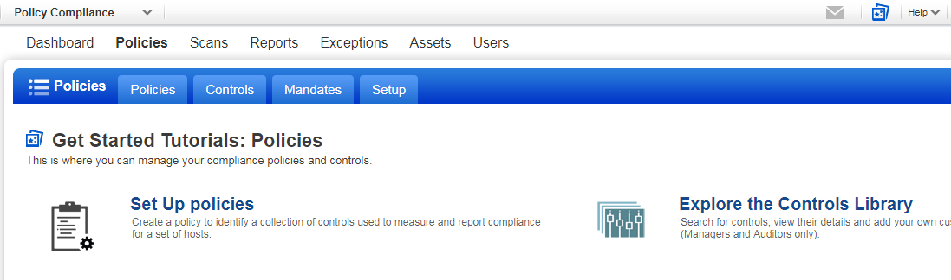
QUALYS POLICY LIBRARIES
EXPLORE THE CONTROLS LIBRARY

Slide 3
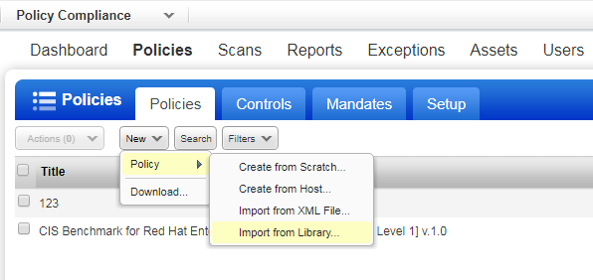
QUALYS POLICY LIBRARIES
CREATE NEW POLICY > IMPORT FROM LIBRARY

Slide 4
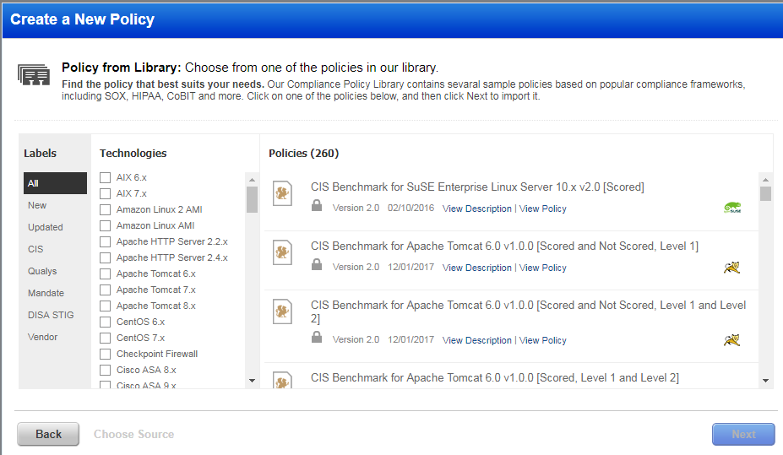
QUALYS POLICY LIBRARIES
CREATE A NEW POLICY

Slide 5
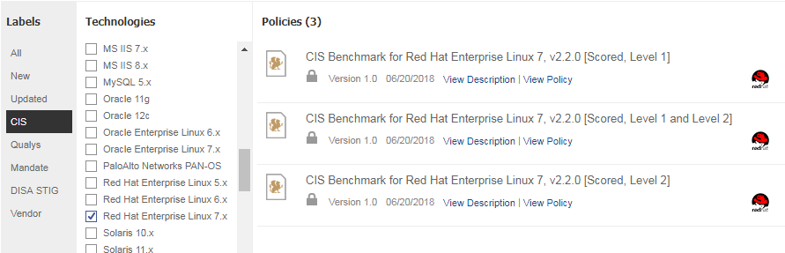
QUALYS POLICY LIBRARIES
CIS > RED HAT ENT. LINUX 7.X

Slide 6
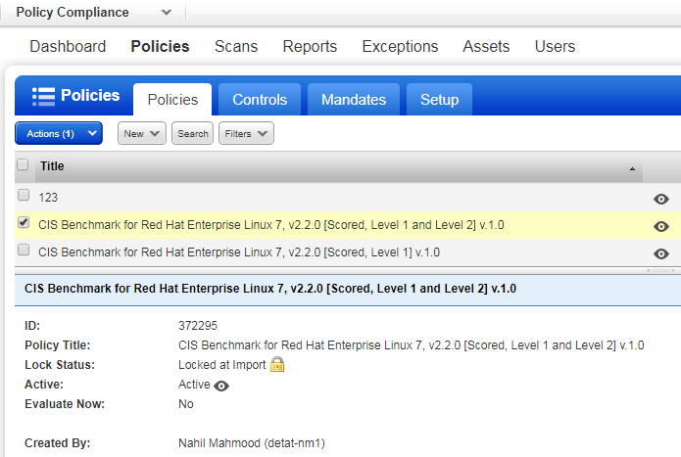
QUALYS POLICY LIBRARIES
POLICIES DASHBOARD

Slide 7
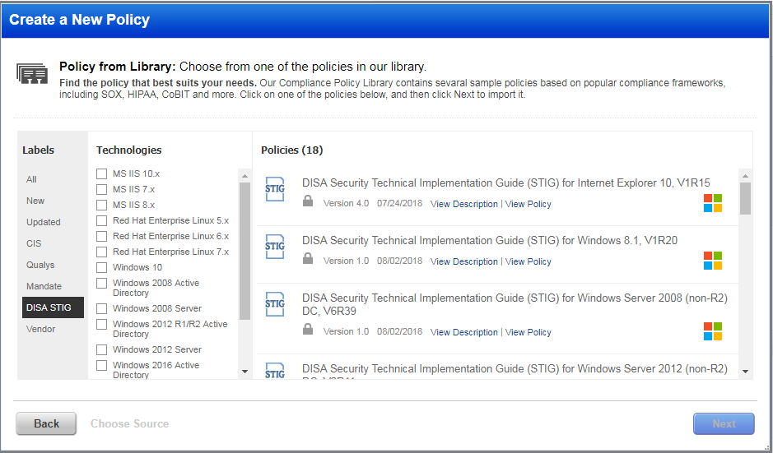
QUALYS POLICY LIBRARIES
DISA STIG

Slide 8
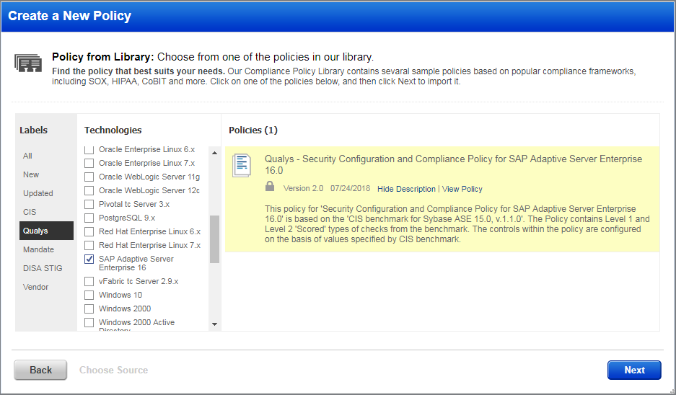
QUALYS POLICY LIBRARIES
QUALYS SAP ADAPTIVE SERVER ENT 16

Slide 9
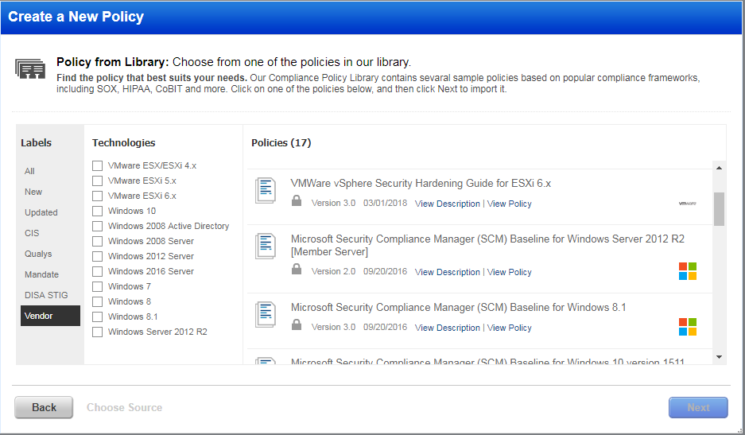
QUALYS POLICY LIBRARIES
VENDOR POLICIES

Slide 10
QUALYS POLICY LIBRARIES
Qualys has a vast number of options for Compliance Scans, and these should be fully explored through the Qualys trial
END

